Slide 1
LESSON 9
BOOK CHAPTER 9
INELASTIC AND ELASTIC COLLISIONS

Slide 2
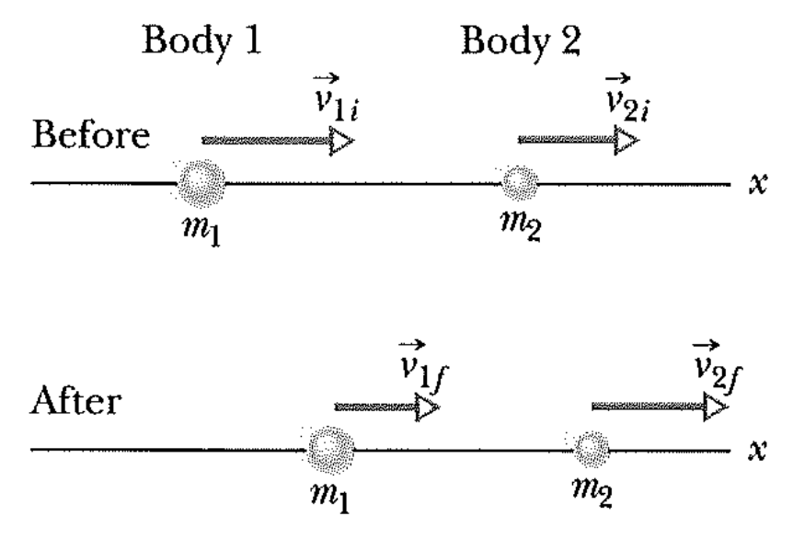


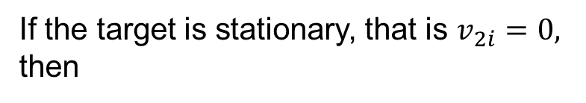
Inelastic Collisions in One Dimension:
In an inelastic collision of two bodies, the kinetic energy of the two-body system is not conserved. If the system is closed and isolated (net external force is zero), the total linear momentum of the system must be conserved.
If the motion of the bodies is along a single axis, the collision is one-dimensional (as shown in the figure).
According to the principle of conservation
of linear momentum, we can write from
the figure
$$m_{1}v_{1i}+m_{2}v_{2i}=m_{1}v_{1f}+m_{2}v_{2f}$$
If the target is stationary, that is $v_{2i}=0,$
then
One-Dimensional Inelastic Collision
$$m_{1}v_{1i}=m_{1}v_{1f}+m_{2}v_{2f}$$

Slide 3
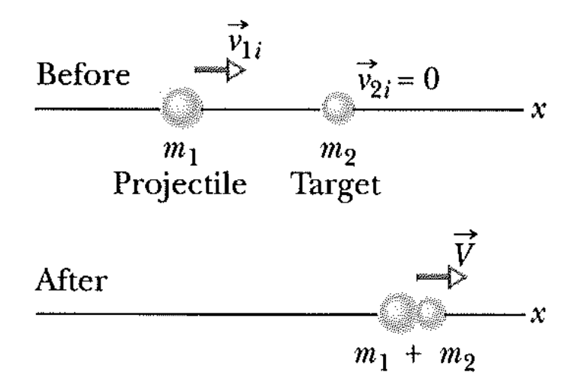

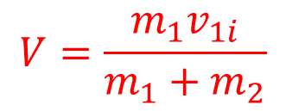
Completely Inelastic Collisions in One Dimension:
If the bodies stick together, the collision is a completely inelastic collision, and the bodies have the same final velocity V (because they are stuck together).
According to the principle of conservation of linear momentum, we can write from the figure
One-Dimensional completely Inelastic Collision
$$m_{1}v_{1i}={(m}_{1}+m_{2})V$$
We can write
$$V=\frac{m_{1}v_{1i}}{m_{1}+m_{2}}$$

Slide 4
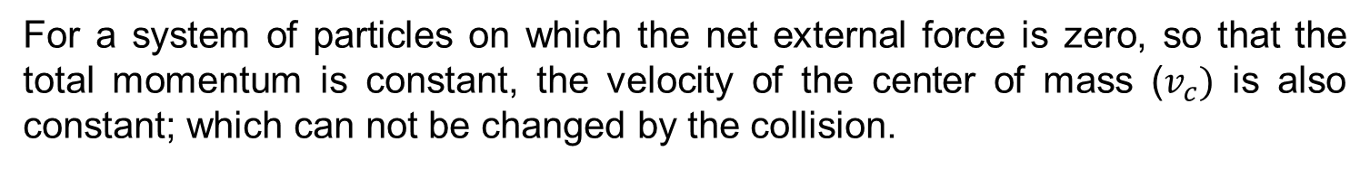
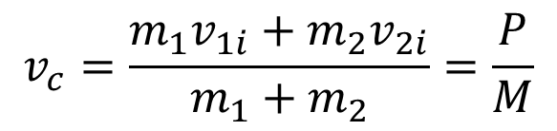
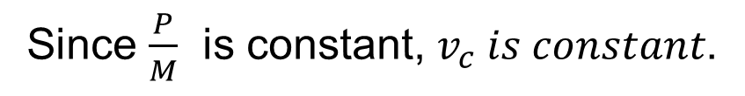
Velocity of the Center of Mass:
For a system of particles on which the net external force is zero, so that the total momentum is constant, the velocity of the center of mass ($v_{c})$ is also constant; which can not be changed by the collision.
We know from LESSON 8
$$v_{c}=\frac{m_{1}v_{1i}+m_{2}v_{2i}}{m_{1}+m_{2}}=\frac{P}{M}$$
Where, total momentum $P{=m}_{1}v_{1i}+m_{2}v_{2i}$ and $M=m_{1}+m_{2}$
Since $\frac{P}{M}$ is constant, $v_{c} is constant$.

Slide 5
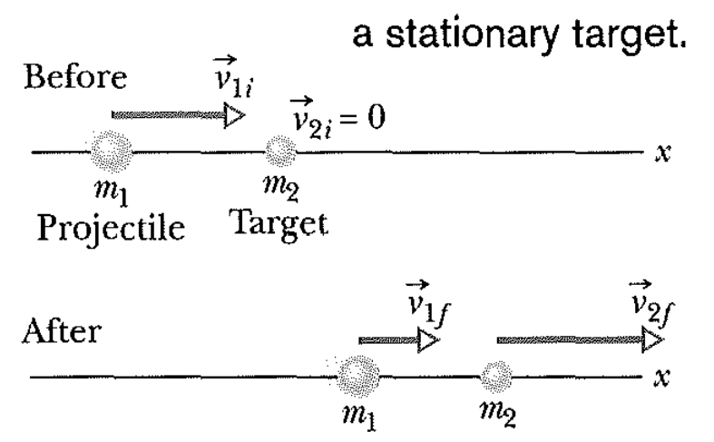
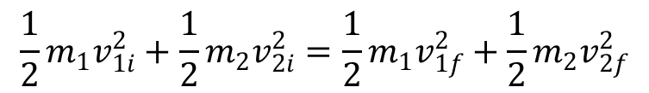

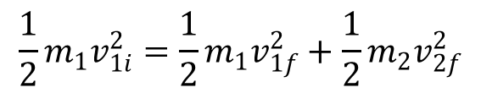

Elastic Collisions in One Dimension:
An elastic collision is a special type of collision in which the kinetic energy of a system of colliding bodies is conserved. If the system is closed and isolated, its linear momentum is also conserved. In an elastic collision, the kinetic energy of each colliding body may change, but the total kinetic energy of the system does not change.
For a one-dimensional collision (as shown in the figure) in which body 2 is a target and body 1 is an incoming projectile, conservation of kinetic energy and linear momentum yield the following expressions:
Total kinetic energy is conserved:
$$\frac{1}{2}m_{1}v_{1i}^{2}+\frac{1}{2}m_{2}v_{2i}^{2}=\frac{1}{2}m_{1}v_{1f}^{2}+\frac{1}{2}m_{2}v_{2f}^{2}$$
Since the target is stationary , $v_{2i}=0$
$$\frac{1}{2}m_{1}v_{1i}^{2}=\frac{1}{2}m_{1}v_{1f}^{2}+\frac{1}{2}m_{2}v_{2f}^{2}$$
$$m_{1}v_{1i}^{2}=m_{1}v_{1f}^{2}+m_{2}v_{2f}^{2}$$
…………….. (1)

Slide 6






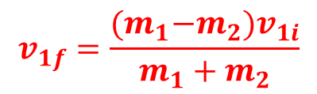




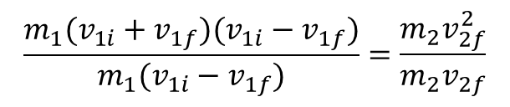



Total linear momentum is conserved:
$$m_{1}v_{1i}+m_{2}v_{2i}=m_{1}v_{1f}+m_{2}v_{2f}$$
Dividing eq^{n}. (4) by eq^{n}. (3)
Since the target is stationary , $v_{2i}=0$
$$\frac{m_{1}(v_{1i}+v_{1f})(v_{1i}−v_{1f})}{m_{1}(v_{1i}−v_{1f})}=\frac{m_{2}v_{2f}^{2}}{m_{2}v_{2f}}$$
$$m_{1}v_{1i}=m_{1}v_{1f}+m_{2}v_{2f}$$
………… (2)
$$v_{1i}+v_{1f}=v_{2f}$$
………… (5)
$$m_{1}v_{1i}−m_{1}v_{1f}=m_{2}v_{2f}$$
From equations (3) and (5) we get
$$m_{1}(v_{1i}−v_{1f})=m_{2}v_{2f}$$
………… (3)
$m_{1}(v_{1i}−v_{1f})=m_{2}(v_{1i}+v_{1f}$)
From equation (1), we can write
$$m_{1}v_{1i}−m_{1}v_{1f}=m_{2}v_{1i}+m_{2}v_{1f}$$
$$m_{1}v_{1i}^{2}−m_{1}v_{1f}^{2}=m_{2}v_{2f}^{2}$$
$$m_{1}v_{1i}−m_{2}v_{1i}=m_{1}v_{1f}+m_{2}v_{1f}$$
$$m_{1}(v_{1i}^{2}−v_{1f}^{2})=m_{2}v_{2f}^{2}$$
$$v_{1f}\left(m_{1}+m_{2}\right)=v_{1i}(m_{1}−m_{2})$$
$$m_{1}(v_{1i}+v_{1f})(v_{1i}−v_{1f})=m_{2}v_{2f}^{2}$$
$$v_{1f}=\frac{{(m}_{1}−m_{2})v_{1i}}{m_{1}+m_{2}}$$
…….. (6)
………… (4)

Slide 7
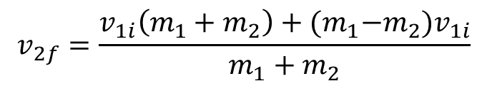

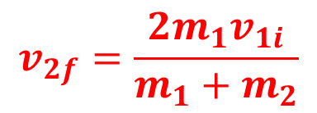
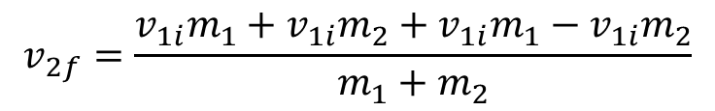
From equations (4) and (5) we get
$v_{2f}=v_{1i}+$ $\frac{{(m}_{1}−m_{2})v_{1i}}{m_{1}+m_{2}}$
$$v_{2f}=\frac{v_{1i}\left(m_{1}+m_{2}\right)+{(m}_{1}−m_{2})v_{1i}}{m_{1}+m_{2}}$$
$$v_{2f}=\frac{v_{1i}m_{1}+v_{1i}m_{2}+v_{1i}m_{1}−v_{1i}m_{2}}{m_{1}+m_{2}}$$
$$v_{2f}=\frac{2m_{1}v_{1i}}{m_{1}+m_{2}}$$

Slide 8
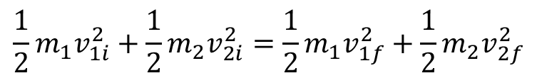
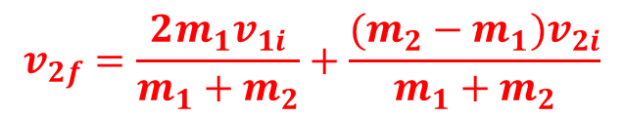
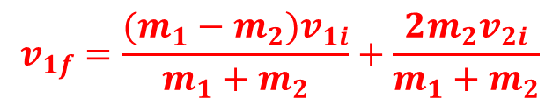

Elastic Collisions in One Dimension (for a moving target):
For a one-dimensional collision (as shown in the figure) in which both bodies are moving before they undergo an elastic collision. Conservation of kinetic energy and linear momentum yield the following expressions:
Total kinetic energy is conserved:
$$\frac{1}{2}m_{1}v_{1i}^{2}+\frac{1}{2}m_{2}v_{2i}^{2}=\frac{1}{2}m_{1}v_{1f}^{2}+\frac{1}{2}m_{2}v_{2f}^{2}$$
Total linear momentum is conserved:
$$v_{1f}=\frac{(m_{1}−m_{2})v_{1i}}{m_{1}+m_{2}}+\frac{2m_{2}v_{2i}}{m_{1}+m_{2}}$$
$$m_{1}v_{1i}+m_{2}v_{2i}=m_{1}v_{1f}+m_{2}v_{2f}$$
$$v_{2f}=\frac{2m_{1}v_{1i}}{m_{1}+m_{2}}+\frac{(m_{2}−m_{1})v_{2i}}{m_{1}+m_{2}}$$
Home Work

Slide 9
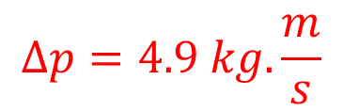

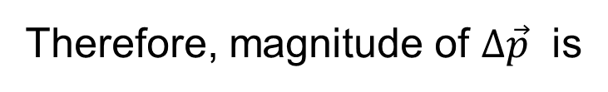

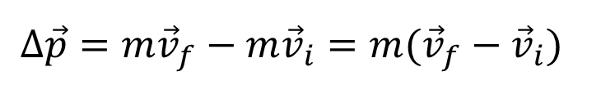

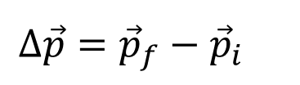

Problem 18 (Book chapter 9):
A 0.70 kg ball moving horizontally at 5.0 m/s strikes a vertical wall and rebounds with speed 2.0 m/s. What is the magnitude of the change in its linear momentum?
Answer:
$$v_{f}$$
Change in linear momentum:
$$∆\vec{p}={\vec{p}}_{f}−{\vec{p}}_{i}$$
$$v_{i}$$
$$∆\vec{p}={m\vec{v}}_{f}−{m\vec{v}}_{i}=m({\vec{v}}_{f}−{\vec{v}}_{i})$$
Here
$v_{i}=5 m/s$
$$∆\vec{p}=0.70\left[2\left(−\hat{i}\right)−5\left(+\hat{i}\right)\right]=0.70\left(−7\hat{i}\right)=−4.9\hat{i}$$
$v_{f}=2 m/s$
Therefore, magnitude of $∆\vec{p}$ is
$$∆p=4.9 kg.\frac{m}{s}$$

Slide 10







Problem 21 (Book chapter 9):
A 0.30 kg softball has a velocity of 15 m/s at an angle of 35⁰ below the horizontal just before making contact with the bat. What is the magnitude of the change in momentum of the ball while in contact with the bat if the ball leaves with a velocity of (a) 20 m/s, vertically downward, and (b) 20 m/s, horizontally back toward the pitcher?
Answer:
(a) Change in momentum along x-axis:
$${35}^{0}$$
$$∆p_{x}=p_{f}−p_{i}=0−mv_{i}\cos{{35}^{0}=−(0.30)(15)(0.8191)}$$
$$v_{i}$$
$$∆p_{x}=−3.686 kg.m/s$$
Change in momentum along y-axis:
$$∆p_{y}=p_{f}−p_{i}=−mv_{f}−\left(−mv_{i}\sin{{35}^{0}}\right)=−\left(0.30\right)\left(20\right)+(0.30)(15)(0.5736)$$
$$∆p_{y}=−6.0+2.5812=−3.4188 kg.m/s$$
Magnitude of $∆\vec{p} is$
Therefore, the net change in momentum:
$$∆p=\sqrt{{(−3.686)}^{2}+{(−3.4188)}^{2} }$$
$$∆\vec{p}=∆p_{x}\hat{i}+∆p_{y}\hat{j}=−3.686 \hat{i}−3.4188 \hat{j}$$
$$∆p=5.027 kg.m/s$$

Slide 11








(a) Change in momentum along x-axis:
$$∆p_{x}=p_{f}−p_{i}=−mv_{f}−mv_{i}\cos{{35}^{0}}$$
$${35}^{0}$$
$$∆p_{x}=−\left(0.30\right)\left(20\right)−\left(0.30\right)\left(15\right)\left(0.8191\right)=−6−3.686$$
$$v_{i}$$
$$∆p_{x}=−9.686 kg.m/s$$
Change in momentum along y-axis:
$$∆p_{y}=p_{f}−p_{i}=0−\left(−mv_{i}\sin{{35}^{0}}\right)=\left(0.30\right)\left(15\right)\left(0.5736\right)=2.5812 kg.m/s$$
Therefore, the net change in momentum:
$$∆\vec{p}=∆p_{x}\hat{i}+∆p_{y}\hat{j}=−9.686 \hat{i}+2.5812 \hat{j}$$
Magnitude of $∆\vec{p} is$
$$∆p=\sqrt{{(−9.686)}^{2}+{(2.5812)}^{2} }$$
$$∆p=10.024 kg.m/s$$

Slide 12







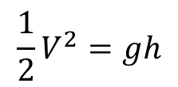
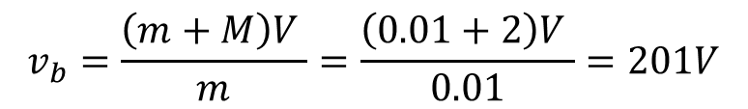


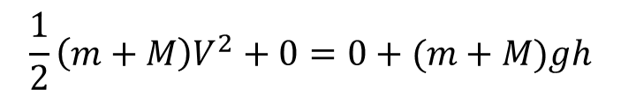
Problem 49 (Book chapter 9):
A bullet of mass 10 g strikes a ballistic pendulum of mass 2.0 kg. The center of mass of the pendulum rises a vertical distance of 12 cm. Assuming that the bullet remains embedded in the pendulum, calculate the bullet’s initial speed.
Answer:
Momentum is conserved throughout the process:
$$mv_{b}=\left(m+M\right)V$$
$$V=0$$
$$v_{b}=\frac{\left(m+M\right)V }{m}=\frac{\left(0.01+2\right)V }{0.01}=201V$$
$$V$$
m
$$h=12cm$$
$$v_{b}$$
$$m+M$$
Conservation of mechanical energy:
$$K_{i}+U_{i}=K_{f}+U_{f}$$
$$V=\sqrt{2gh}=\sqrt{2(9.8)(0.12)}=1.5336 m/s$$
$$\frac{1}{2}\left(m+M\right)V^{2}+0=0+(m+M)gh$$
Therefore,
$$\frac{1}{2}V^{2}=gh$$
$$v_{b}=\left(201\right)\left(1.5336\right)=308.25 m/s$$

Slide 13



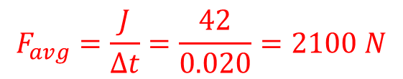

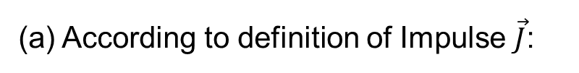





Problem 25 (Book chapter 9): Home Work
A 1.2 kg ball drops vertically onto a floor, hitting with a speed of 25 m/s. It rebounds with an initial speed of 10 m/s. (a) What impulse acts on the ball during the contact? (b) If the ball is in contact with the floor for 0.020 s, what is the magnitude of the average force on the floor from the ball?
Answer:
(a) According to definition of Impulse $\vec{J}$:
$$v_{i}$$
$$\vec{J}=∆\vec{p}={\vec{p}}_{f}−{\vec{p}}_{i}=mv_{f}\left(+\hat{j}\right)−mv_{i}(−\hat{j})$$
$$v_{f}$$
$$\vec{J}=∆\vec{p}=\left(1.2\right)\left(10\right) \hat{j}+\left(1.2\right)\left(25\right)\hat{j}$$
$$v_{i}=25 m/s$$
$$\vec{J}=∆\vec{p}=12 \hat{j}+30 \hat{j}=42 \hat{j} kg.m/s$$
$$v_{f}=10 m/s$$
Magnitude:
$$J=∆p=42 kg.m/s$$
OR
$$J=∆p=42 N.s$$
(b) we can write the magnitude of the impulse as
$$J=F_{avg} ∆t$$
$$F_{avg}=\frac{J}{∆t}=\frac{42}{0.020}=2100 N$$

Slide 14
Thank You

